Slide 1

OBDA
Ismail Mayouf

Slide 2
Agenda
Introduction to OBDA
Mapping Translation in OBDA
Scenarios and Challenges in OBDA
Practical Applications and Implications
Conclusions

Slide 3

Introduction to OBDA
Need for ‘self-service’ data access by end-users
Direct data access is challenging
Complex schemata: N- numbers of tables
Conceptual mismatch: user’s view vs DB Schemata
Common Data access Approach
Specialized applications with predefined queries
Not Sufficient: IT Experts have to be involved

Slide 4
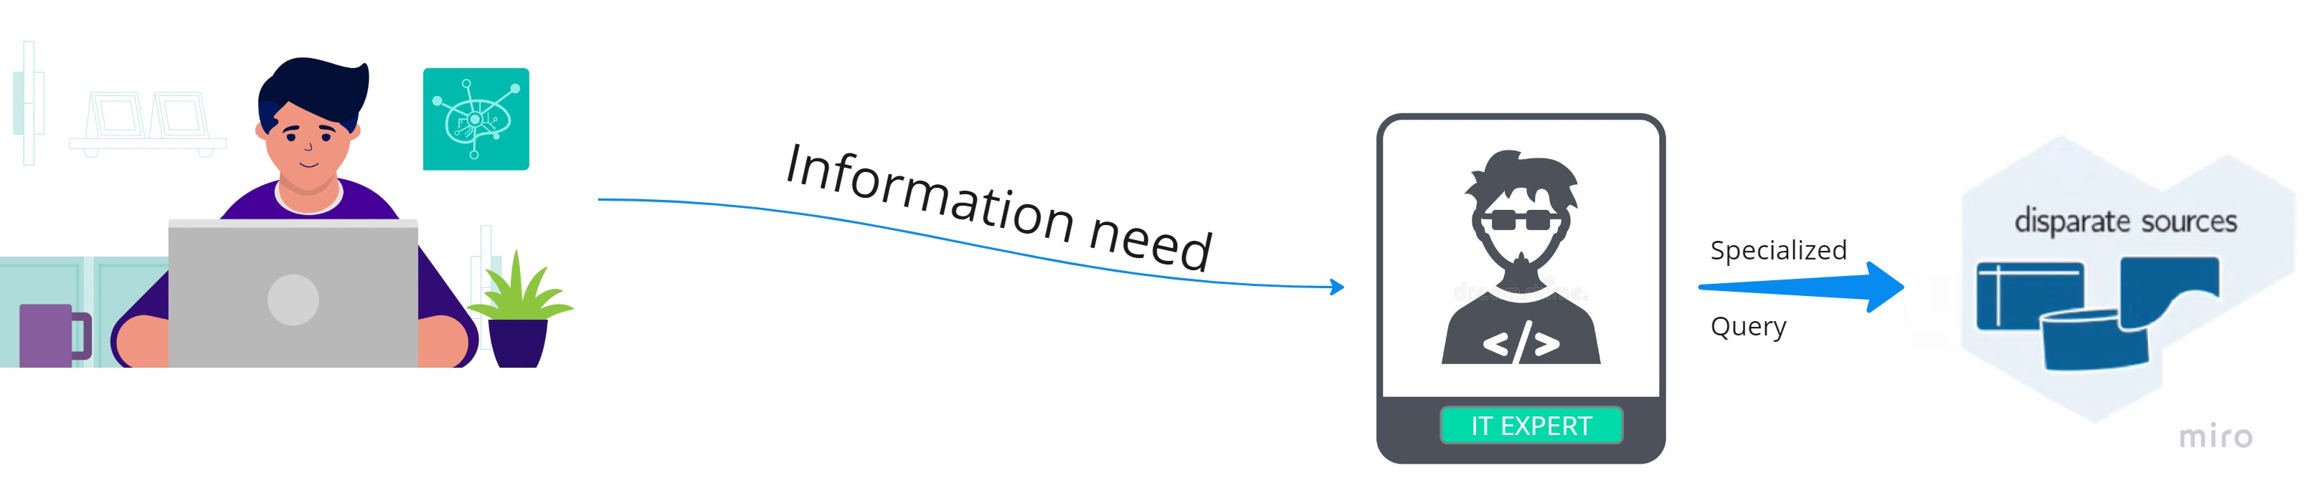
Introduction to OBDA
IT Experts are a bottle-neck of data access

Slide 5
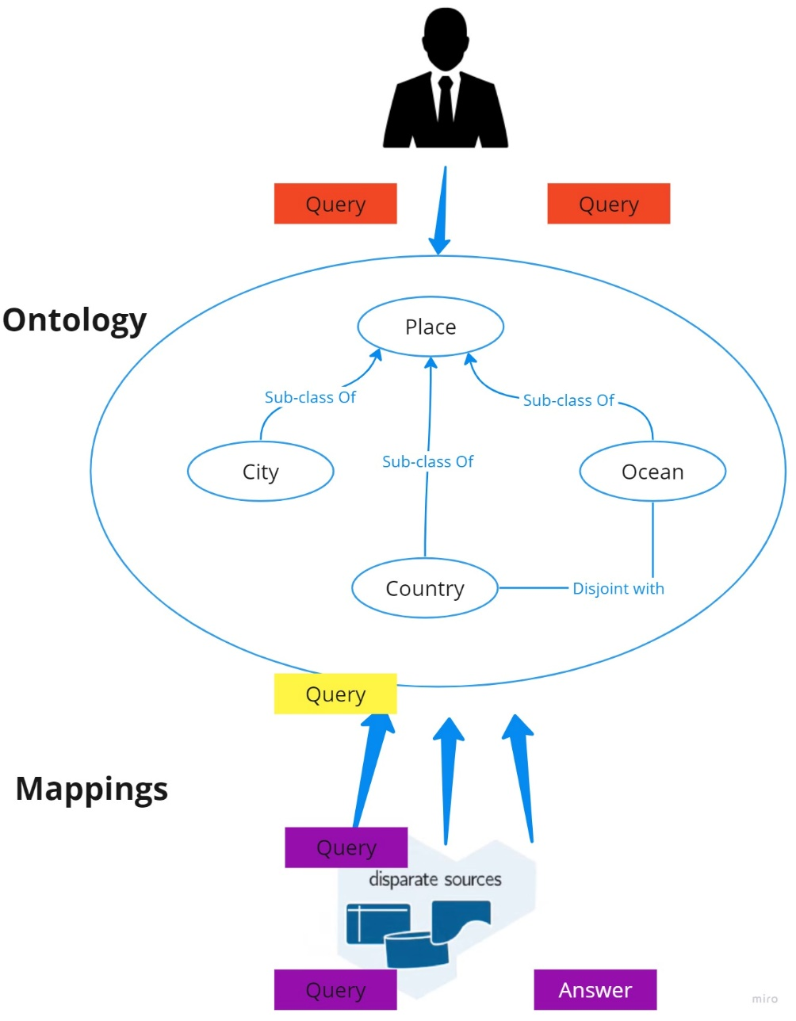
Introduction to OBDA
What is OBDA?
Data Access and integration
Virtual: data stays where it is
Ontology:
Mediates users and data
Formal description of domain in user-oriented terms
Mappings ‘Connect’ ontology to data
Limitations
Expensive startup, maintenance cost
Building and maintaining ontologies and mappings
End-users have to learn a machine-oriented query language

Slide 6
Mapping Translation in OBDA
Definition:
Mapping translation in OBDA is defined as a function that transforms a set of mappings
described in one language (original mappings) into a set of mappings described in another
language (target mappings)​​.

Slide 7
Desirable Properties of Mapping Translation
Information Preservation Property (IPP)
Ensures that the application of target mappings over the original data source returns the same information as the original mappings applied to the same data source.
Query Result Preservation Property (QRPP)
States that for any query evaluated over the information generated from the original mappings, there is a way to generate an equivalent query for the target mappings that yields the same results​

Slide 8
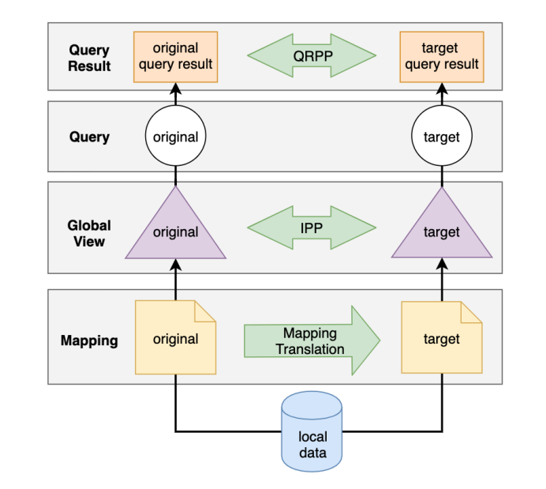
Mapping Translation Graph
This figure demonstrates how the results (represented by triangles) may satisfy the IPP property when both the source and target mappings are applied to the same data. Similarly, it shows that the query results (depicted as rectangles) may satisfy the QRPP property when equivalent queries are evaluated over the source and target results​

